Slide 1
JJCPA Fiscal Year 2023-24 Allocation Juvenile Justice Coordinating Council January 19, 2023 (2:00 pm – 4:00 pm)

Slide 2
FY 2023-2024 JJCC-CMJJP Ad-Hoc Subcommittee Members
Adam Bettino – Los Angeles County Probation Department, (Co-Chair)
Mercy Santoro – Los Angeles County Parks and Recreation, (Co-Chair)
Tricia Penrose – Superior Court, Juvenile Division
Luis Rodriguez – Public Defender’s Office
Dr. Karen Streich – Department of Mental Health
Josh Green – Non-Profit Community Based-Organization Supervisorial Representative, District 3
Bikila Ochoa – Non-Profit Community-Based Organization Supervisorial Representative District 1

Slide 3
Resolution to Appoint JJCC-CMJJP Ad-Hoc Subcommittee
JJCC Resolution – January 19, 2023
Propose a CMJJP for FY 2024-25 for JJCC consideration at its December 6, 2023, meeting; and,
Make recommendations as to the spending of the FY 2024-25 JJCPA Base and Growth funds for JJCC consideration at its December 6, 2023, meeting.

Slide 4
JJCC-CMJJP Ad-Hoc Subcommittee Scheduled Meeting Hours for the Last Three Fiscal Years (FY 2021-22 - FY 2023-2024)
FY 2021-2022: Total of 13 Scheduled Ad-Hoc Subcommittee Meeting Hours
FY 2022-2023: Total of 20.5 Scheduled Ad-Hoc Subcommittee Meeting Hours
FY 2023-2024: Total of 25 Scheduled Ad-Hoc Subcommittee Meeting Hours
An increase of approximately 92% (from 13 to 25) in meeting hours, from FY 2021-2022 to FY 2023-2024 for the Scheduled Ad-Hoc Subcommittee Meetings

Slide 5
JJCC-CMJJP Ad-Hoc Subcommittee - “Rules of the Road”
Subcommittee (and JJCC) may recommend categories (e.g. primary prevention or intervention), programs and projects (e.g. substance abuse prevention in A City), but can only recommend specific providers if those providers are governmental agencies or subject to a Board contract (e.g. LAC Dept. of B or the P/PP). We cannot recommend any other specific providers (i.e. named CBOs).
Conflict of interest rules apply to our work in the subcommittee, so be thoughtful about recommendations for funding.
Surface issues that you spot, but please provide solutions along with the issues.
We have been given a specific two-part mission (FY 2020-21 CMJJP and funding allocation) and a tight timeline to accomplish it. In order to get to our deliverables we need to be mission-focused on the work in front of us.
Along the way we will spot issues outside of our two-part mission, and we don’t want to ignore or forget them. So we will be using a “parking lot” approach where issues that are outside our mission will go and we direct them to the appropriate channels (e.g. JJCC-CAC or a new JJCC Governance and Procedure Subcommittee).

Slide 6
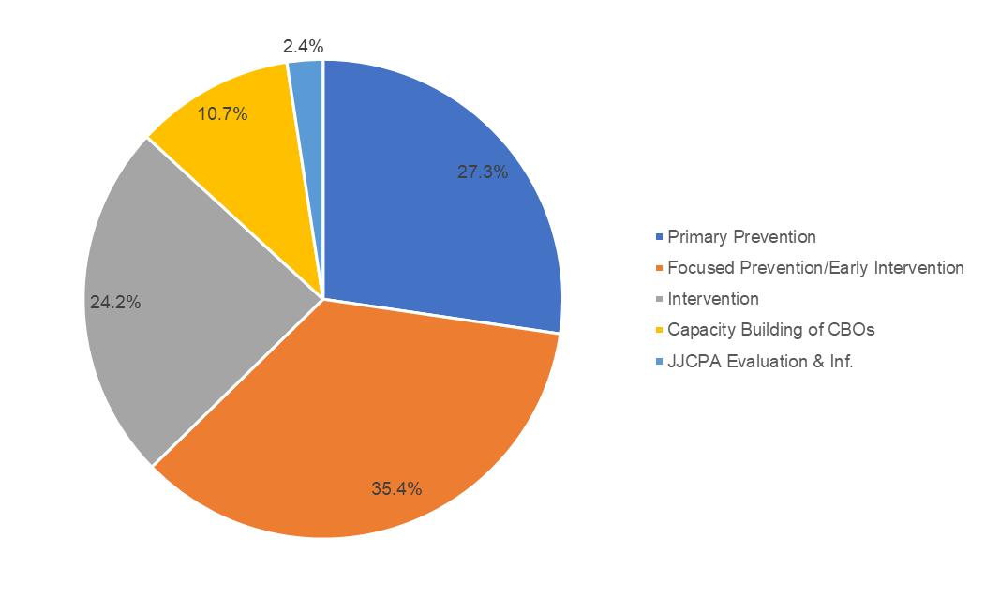
Notes:
Carryover balance increased by $22.4M for FY 2022-23 (due in part to Covid-19 impacts)
8 (or 23%) out of 35 agencies selected more than 1 continuum category

Slide 7
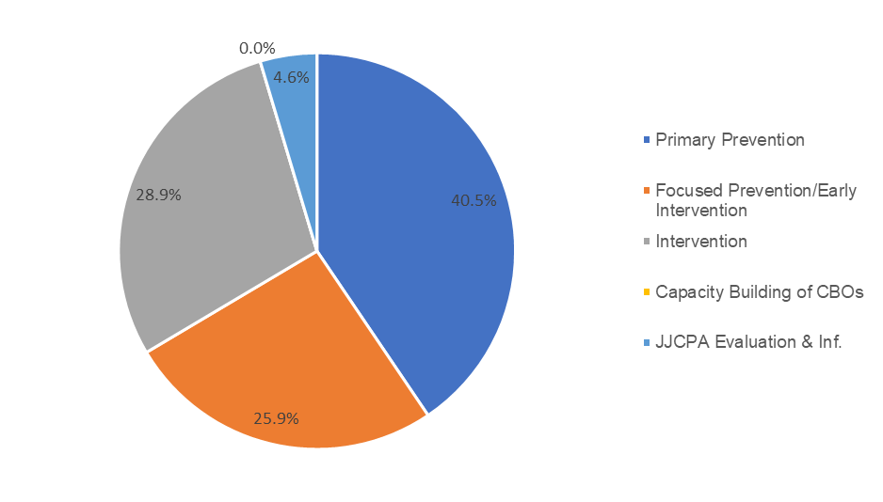
Notes:
14.8.% increase in Base-Funded Primary Prevention
6.4% reduction in Base-Funded Focused Prevention/Early Intervention
6.7% reduction in Base-Funded Intervention

Slide 8
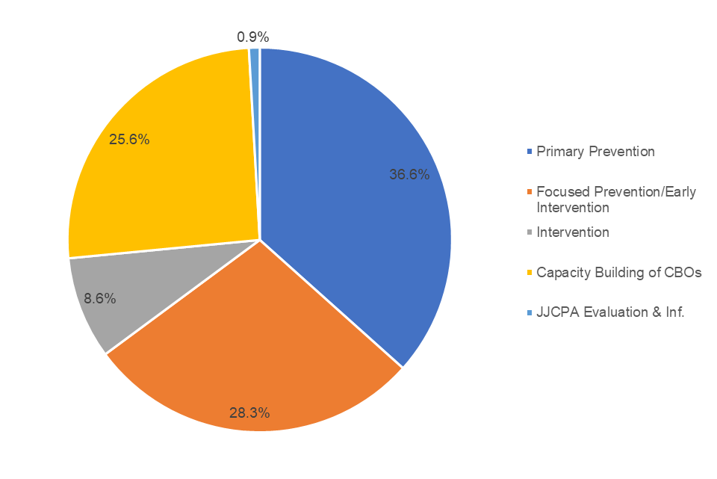
2019-2020 Projected JJCPA Spending (Growth)
Continuum Category | Growth Funds | Change from 2018-19 | Allocation | Model Alloction
Primary Prevention | $ 5,411,165.20 | $ (5,027,325.80) | 40.0% | 40%
Focused Prevention/Early Intervention | $ 3,381,978.25 | $ (9,118,021.75) | 25.0% | 25%
Intervention | $ 3,381,978.25 | $ (17,218,021.75) | 25.0% | 25%
Capacity Building of CBOs | $ 676,395.65 | $ (223,604.35) | 5.0% | 5%
JJCPA Evaluation & Inf. | $ 676,395.65 | $ 96,395.65 | 5.0% | 5%
 | $ 13,527,913.00 | $ (31,490,578.00) | 100.0% | 100.0%
Largest growth-based allocations:
P/PP Grant ($12.93M)
P/PP Capacity ($4.50M)
DYD ($8.21M)
Arts ($5.32M)

Slide 9
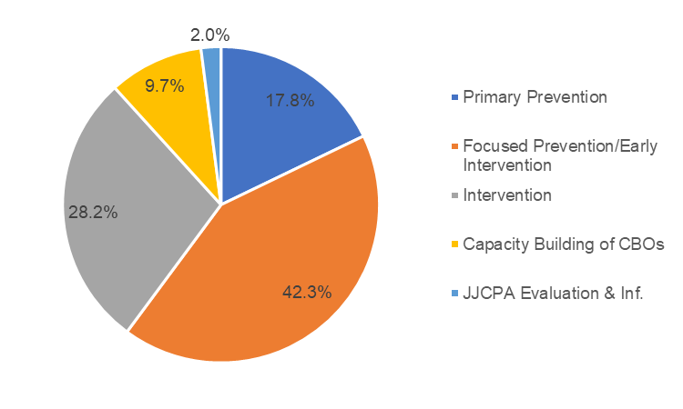
Notes:
Focused Prevention/Early Intervention spending increased by 34%
All other categories indicate decreased spending

Slide 10
Closing Co-Chair Recommendations
Keep following the “Rules of the Road”
Conflict of interest rules apply to our work in the subcommittee, so be thoughtful about recommendations for funding.
Surface issues that you spot, but please provide solutions along with the issues.
Document and direct issues to the appropriate channels (e.g. JJCC-CAC or a new JJCC Governance and Procedure Subcommittee)
Make the most out of our time for discussion
Limit ourselves to one three-minute speech per motion
Let the proponent of a motion go first
Alternate between speakers for and against the motion so we know when the main points have been raised

